Slide 1


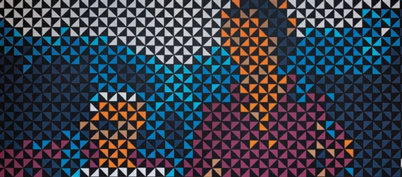
EXPERIMENT 3: PEOPLE
Mentor Artist: Sam Tupou
Lens Focus: Psychological
This experiment investigates how artists represent people beyond physical likeness to communicate identity, internal experience, and cultural memory.
FIA1 OVERARCHING INQUIRY QUESTION: How can reinterpreting people, places and objects through an artistic lens communicate my viewpoint about connection?
EXPERIMENT 3: SUB-QUESTION:
How can symbolic portraiture communicate psychological and identity-based meaning about a person?

Slide 2
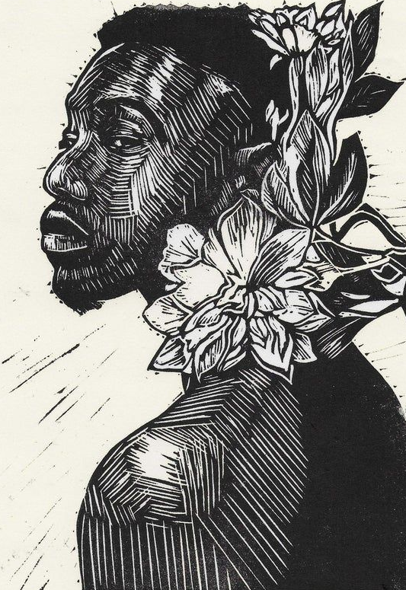
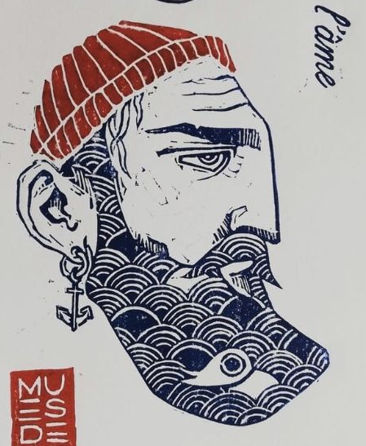
Focus Lens:
Psychological
PRACTICAL ACTIVITY
Task: Symbolic Portrait
Create a portrait that communicates aspects of identity, memory, or internal experience using symbolic visual language rather than realism alone.
Objective: To explore how the psychological lens can communicate connection to people through symbolism, pattern, and composition.
Instructions:
Select a person of significance, either yourself or someone connected to you.
Incorporate visual strategies such as:
• symbolic imagery
• pattern
• repetition
• compositional emphasis
Your work should communicate what this person represents psychologically, culturally, or emotionally, not just how they appear physically.
Personal Context: Consider how this person shapes your understanding of identity or belonging.
Contemporary Context: Reflect on how identity is constructed and represented in a multicultural, globalised society.

Slide 3



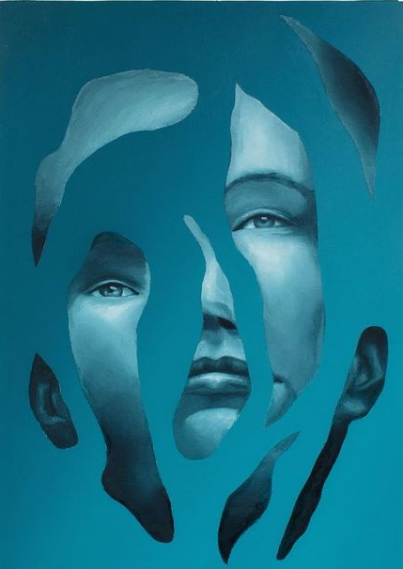
This question guides your experiment.
How can visual symbols communicate aspects of identity that are not physically visible?
This lens supports the inquiry by allowing artists to communicate their personal viewpoint about connection to people through internal and symbolic representation.
The psychological lens moves beyond surface description to investigate internal experience.
HOW THE LENS OPERATES IN PORTRAITURE
Psychological portraiture prioritises internal meaning over physical likeness. It constructs identity through abstraction, symbolism, and compositional control.
Instead of asking whether the portrait resembles the subject, the viewer considers what it reveals about their internal world.
Artists may:
fragment or distort form to suggest complexity
layer symbolic imagery to represent memory or heritage
manipulate colour and pattern to communicate mood and identity
Meaning is interpreted rather than recognised. Through these strategies, the artist communicates a personal viewpoint about identity and connection.
It examines how artists represent:
identity
emotion
memory
cultural belonging
tension between past and present
Through this lens, portraiture shifts from documenting appearance to constructing meaning about who a person is.

Slide 4


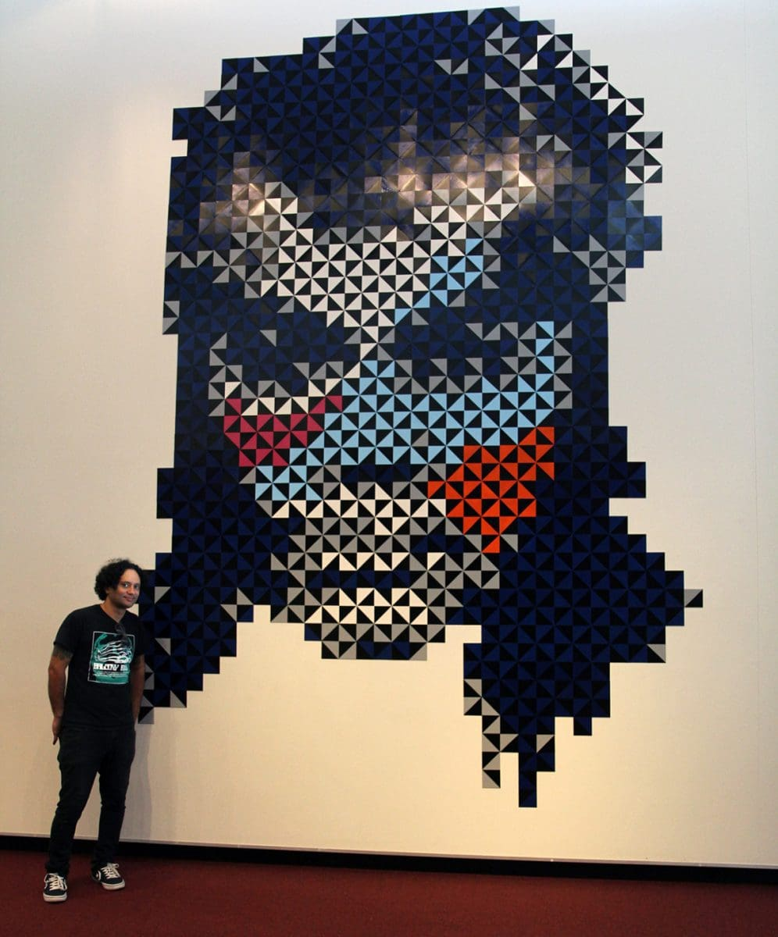
Sam Tupou is a contemporary Australian artist of Polynesian heritage. His practice merges traditional Polynesian visual language with contemporary graphic and digital aesthetics.
He explores:
• cultural identity
• hybridity
• heritage
• modernity
• belonging within contemporary society
His work positions pattern as a symbolic language rather than decoration
Key Themes in Tupou's Work:
the preservation of cultural memory
the impact of globalization
tradition versus technological modernity
identity in diasporic contexts
Pattern in his work operates as cultural code. It carries ancestral knowledge and collective identity.
This transforms portraiture into a site of cultural storytelling.

Slide 5
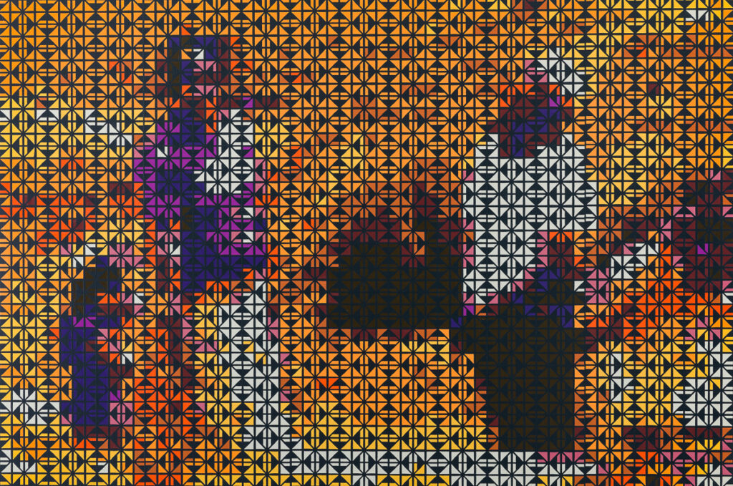
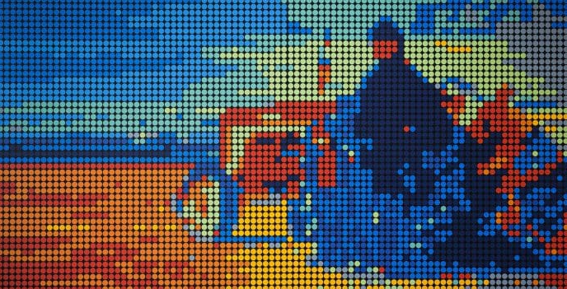
Pixel Fades Series
In his Pixel Fades series, Sam Tupou merges traditional Polynesian patterns with digital pixelation to explore how cultural identity shifts within contemporary society.
Key Ideas
Combines heritage motifs with digital aesthetics
Uses repetition and geometric abstraction to express continuity and change
Blurs boundaries between tradition and technology
Examines how globalisation influences cultural identity
Personal Context:
Reflects Tupou’s negotiation of his Polynesian heritage within a modern digital world.
Contemporary Context:
Responds to concerns about cultural preservation and transformation in an increasingly technological society.

Slide 6
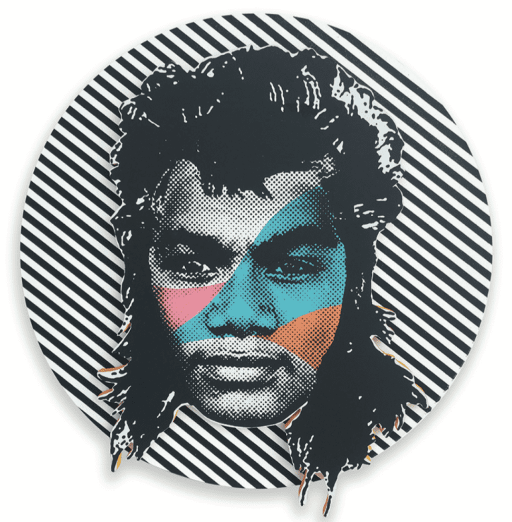
Psychological Lens in the Series:
Across his practice, Tupou uses traditional Polynesian pattern as a visual language of identity.
Rather than functioning as decoration, pattern becomes symbolic of:
cultural memory
Ancestry
Belonging
collective identity
By manipulating and recontextualising these patterns within contemporary formats, Tupou suggests the psychological negotiation between heritage and modern life.
His portraits do not simply depict individuals. They represent internal cultural experience, where identity is shaped by both continuity and disruption.
Through the psychological lens, his work explores how cultural identity is constructed, remembered, and transformed within contemporary society.
Visual and Symbolic Elements
Tupou constructs meaning through:
repetition and rhythm
geometric abstraction
bold, high-contrast colour
layering of traditional and digital aesthetics
controlled composition
These formal decisions create tension between continuity and disruption.
The visual fragmentation often reflects psychological negotiation between past and present identities.

Slide 7

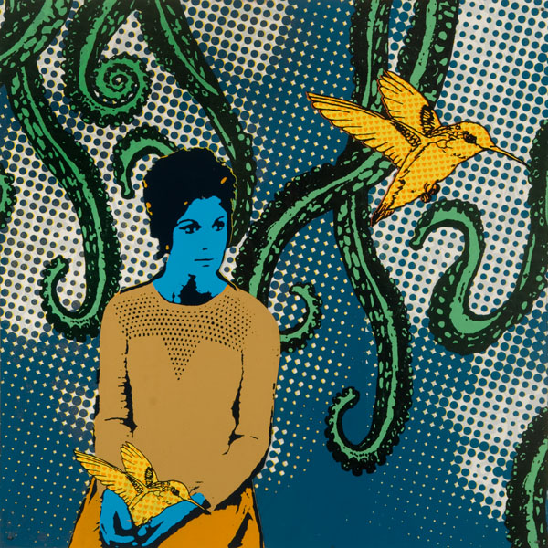
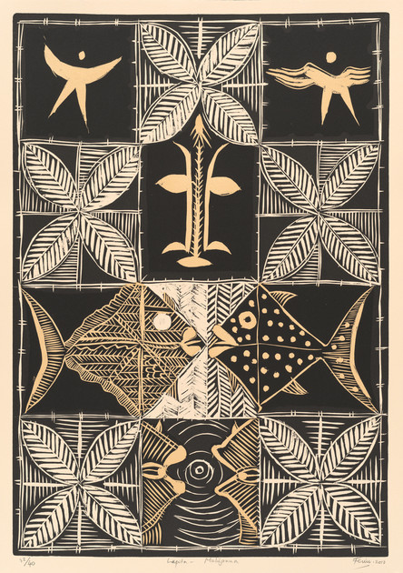

Tupou → Transformation of Polynesian symbolic tradition through digital aesthetics
Feu’u → Recontextualisation of Polynesian symbolic tradition within contemporary art
Historical Link: Fatu Feu'u and Polynesian tapa traditions
Traditional Polynesian tapa artists used repeated pattern and symbolic design to communicate genealogy, identity, and cultural narratives. Fatu Feu’u recontextualised these traditions within contemporary fine art practice, elevating Pacific visual language within global art discourse.
Tupou extends this lineage by integrating traditional pattern with digital aesthetics. This demonstrates how cultural symbolism evolves while maintaining continuity of meaning.

Slide 8

Aspect | Fatu Feu’u (Historical) | Sam Tupou (Contemporary)
Time period | Late 20th-century Pacific modernism | Contemporary Australian practice
Art form | Painting informed by tapa traditions | Painting, print and digital-based works
Core concern | Cultural identity and Pacific symbolism | Cultural identity within digital global culture
Subject matter | Symbolic forms derived from Polynesian motifs | Portraiture layered with Polynesian pattern
Visual system | Repetition, symmetry and bold flat colour | Geometric pattern, pixelation and fragmentation
Use of pattern | Pattern as ancestral language | Pattern as cultural and psychological negotiation
Stability of identity | Identity grounded in cultural continuity | Identity negotiated between heritage and modernity
Experience of viewer | Reflective engagement with symbolic imagery | Active interpretation of layered cultural meaning
Psychological effect | Affirmation of cultural pride and memory | Exploration of internal cultural tension
Relationship to tradition | Reclaims and elevates tapa symbolism within fine art | Transforms traditional symbolism through digital aesthetics
Central idea | Cultural preservation and visibility | Cultural transformation and hybridity
Tupou extends Feu’u’s reclamation of Polynesian visual language, shifting it from cultural affirmation to psychological negotiation within a digital contemporary context.

